Slide 1

MUSIC STORE DATA MANAGEMENT SYSTEM
A Relational Database Management System

Slide 2
ABOUT ME
NIVETHA S
BACKGROUND: B.E (CSE)
WHY DATA SCIENCE: Exploring data, discovering insights, and solving real-world problems.
EXPERIENCE: FRESHER
LINKEDIN: LINKEDIN URL
GITHUB: GITHUB URL

Slide 3
OBJECTIVE:
Design and implement a relational database with appropriate constraints.
Import and validate CSV data into the music store tables.
Use SQL joins, aggregations, subqueries and ranking techniques.
Analyze sales, customers, genres, artists and geographic trends.
Convert database results into clear business insights.

Slide 4
PROBLEM STATEMENT:
The music store contains multiple related tables and a large number of records.
Business users need answers about sales, customers, artists, genres and countries.
Manual analysis is difficult because information is distributed across tables.
SQL is used to connect, filter, aggregate and rank the data efficiently.
The final analysis should support promotional and customer-focused decisions.

Slide 5
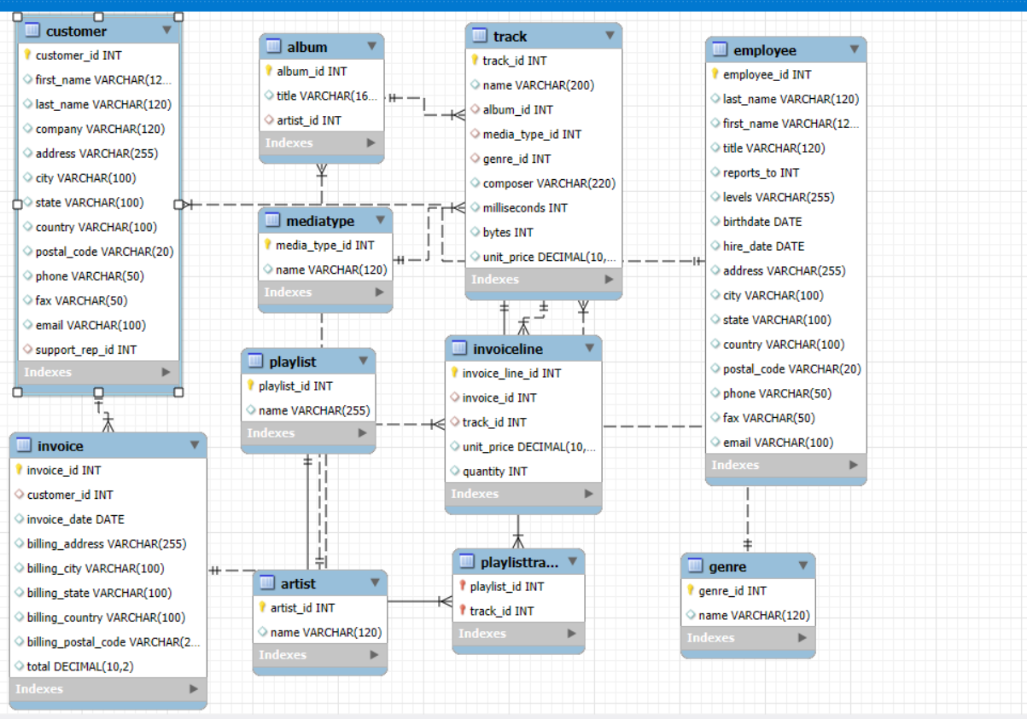
ER DIAGRAM:

Slide 6
TECHNIQUES USED & KEY FEATURES:
TECHNIQUES USED
KEY FEATURES
MySQL relational database design
Primary keys and foreign keys
INNER JOINs across related tables
GROUP BY with COUNT and SUM
ORDER BY and LIMIT for ranking
Subqueries for dynamic comparisons
Common Table Expressions (CTEs)
DENSE_RANK() with PARTITION BY for rankings and ties
CSV data import and validation
Sales, customer and invoice analysis
Artist and genre analysis
Country-level comparisons
Identification of high-value customers and top results
Business-focused interpretation of SQL results

Slide 7
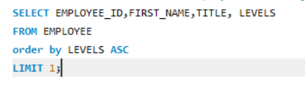
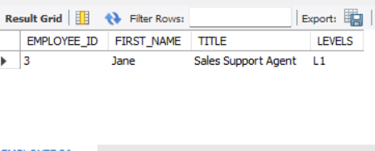
KEY ANALYSIS:
Q. Who is the senior most employee based on job title?
QUERY:
OUTPUT:
KEY INSIGHTS:
Identifies the employee with the highest seniority based on the employee level.
The analysis helps understand the organizational hierarchy within the company.

Slide 8
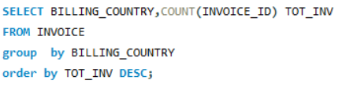
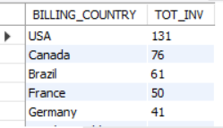
Q. Which countries have the most Invoices?
QUERY:
OUTPUT:
KEY INSIGHTS:
Analyzes invoice activity across different billing countries.
The results show USA as the country with the highest number of invoices.

Slide 9
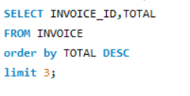
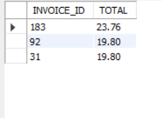
Q. What are the top 3 values of total invoice?
QUERY:
OUTPUT:
KEY INSIGHTS:
Identifies the three invoices with the highest transaction values.
The analysis highlights the largest individual purchases recorded in the store.

Slide 10
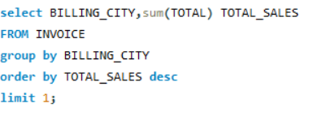
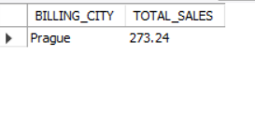
Q. Which city has the best customers? - We would like to throw a promotional Music Festival in the city we made the most money. Write a query that returns one city that has the highest sum of invoice totals. Return both the city name & sum of all invoice totals
QUERY:
OUTPUT:
KEY INSIGHTS:
Compares total sales generated by different billing cities.
Prague records the highest total sales of 273.24 in the analysis.

Slide 11
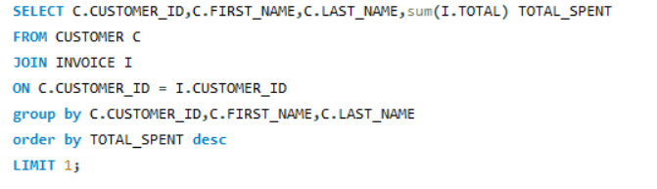

Q. Who is the best customer? - The customer who has spent the most money will be declared the best customer. Write a query that returns the person who has spent the most money
QUERY:
OUTPUT:
KEY INSIGHTS:
Analyzes customer spending to identify the highest-value customer.
František Wichterlová is the top customer with total spending of 144.54.

Slide 12
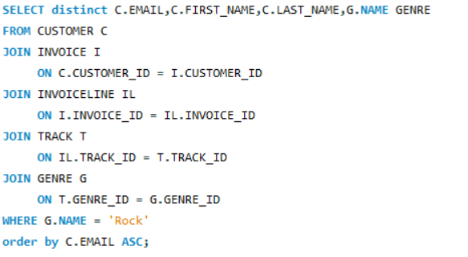
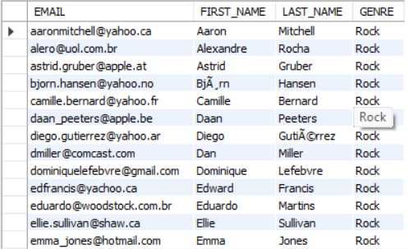
Q. Write a query to return the email, first name, last name, & Genre of all Rock Music listeners. Return your list ordered alphabetically by email starting with A
QUERY:
OUTPUT:
KEY INSIGHTS:
Identifies customers who purchased tracks belonging to the Rock genre.
The analysis helps understand the customer base interested in Rock music.

Slide 13
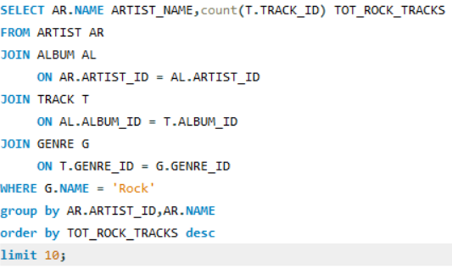
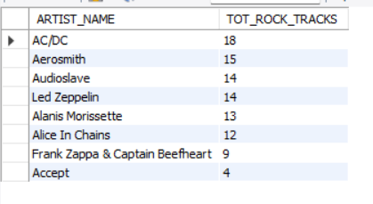
Q. Let's invite the artists who have written the most rock music in our dataset. Write a query that returns the Artist name and total track count of the top 10 rock bands
QUERY:
OUTPUT:
KEY INSIGHTS:
Analyzes the number of Rock tracks available for each artist.
AC/DC has the highest number of visible Rock tracks, with 18 tracks.

Slide 14
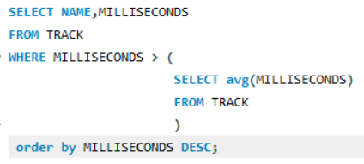
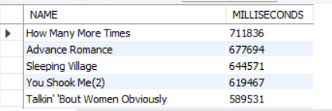
Q. Return all the track names that have a song length longer than the average song length.-Return the Name and Milliseconds for each track. Order by the song length, with the longest songs listed first
QUERY:
OUTPUT:
KEY INSIGHTS:
Identifies tracks whose duration is greater than the average track length.
How Many More Times is the longest visible track in the resulting list.

Slide 15
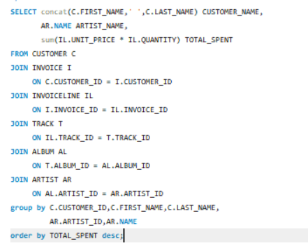
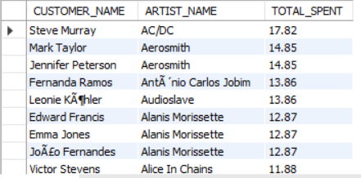
Q. Find how much amount is spent by each customer on artists? Write a query to return customer name, artist name and total spent
QUERY:
OUTPUT:
KEY INSIGHTS:
Analyzes how much individual customers spend on different artists.
Steve Murray has the highest visible spending, with 17.82 spent on AC/DC.

Slide 16
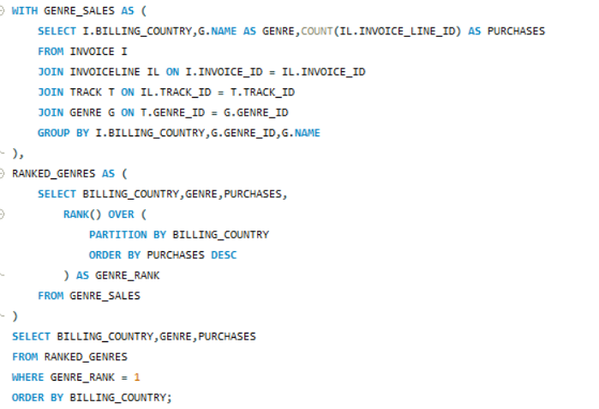
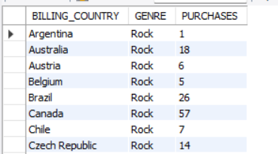
Q. We want to find out the most popular music Genre for each country. We determine the most popular genre as the genre with the highest amount of purchases. Write a query that returns each country along with the top Genre. For countries where the maximum number of purchases is shared, return all Genres
QUERY:
OUTPUT:
KEY INSIGHTS:
Identifies the most purchased music genre separately for each country.
Rock is the top genre across all the countries visible in the output.

Slide 17
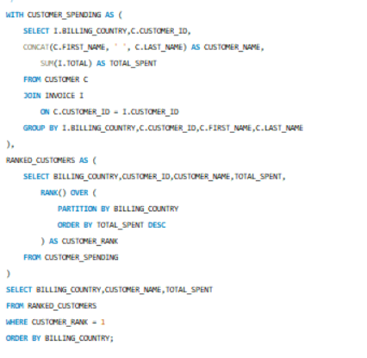
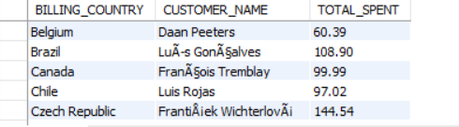
Q. Write a query that determines the customer that has spent the most on music for each country. Write a query that returns the country along with the top customer and how much they spent. For countries where the top amount spent is shared, provide all customers who spent this amount
QUERY:
OUTPUT:
KEY INSIGHTS:
Identifies the highest-spending customer within each billing country.
The analysis helps understand top customers and their spending patterns across different markets.

Slide 18
CHALLENGES FACED:
Understanding relationships between tables and choosing the correct JOIN path.
Maintaining data consistency through primary and foreign key constraints.
Handling aggregation when multiple tables are joined together.
Working with date, quantity and price fields while calculating business metrics.
Using ranking logic to handle country-level winners and tied results.

Slide 19
CONCLUSION:
The project demonstrates how SQL can turn relational music-store data into insights.
Joins connect business entities while aggregation summarizes sales and spending.
Subqueries and window functions solve more advanced analytical requirements.
The analysis identifies high-value customers, cities, artists, genres and countries.
Overall, the project strengthens practical database and SQL analysis skills.

Slide 20

THANK YOU

